Slide 1
Custom components pt 3 - events
Encapsulated, single-responsibility, reusable code

Slide 2

Contents
What is an event and how can we use it?
What is a custom event?
How can we generate a custom events?

Slide 3
What is an event?
HTML events are "things" that happen to HTML elements.
mouse clicks (and moves), data entry (keys), page finished loading, window resize, element select, copy/past, etc.

Slide 4
How to use an event
In javascript we can listen to events
When an event occurs, we can take an appropriate action
Often these actions involve letting other parts of the application know that something has changed
Many standard components handle events (and something generate other events

Slide 5
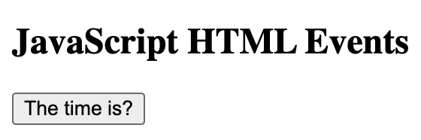
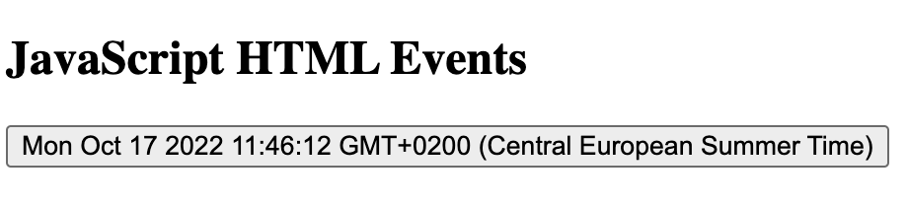
Code example
When the button is clicked…
<!DOCTYPE html>
<html>
<body>
<h2>JavaScript HTML Events</h2>
<button onclick="this.innerHTML=Date()">The time is?</button>
</body>
</html>
… do this!
Click

Slide 6
Events in a custom component
Assignment
Make a custom component that displays a value
When the user clicks on that value, increment it
And display the new value

Slide 7
SimpleCounter example
Create a new custom component
export class SimpleCounter extends HTMLElement {
constructor() {
// Always call the super
super();
// Initialize
this.DEFAULT_VALUE = 0;
this.DEFAULT_LABEL = 'Counter: ‘;
this.DEFAULT_INCREMENT = 1;
}
}
customElements.define('simple-counter', SimpleCounter);
Create a constructor
Avoid the use of magic numbers
Create the html tag

Slide 8
SimpleCounter example
Called when the component is added to the DOM
Set the start value
connectedCallback() {
this.value = this.DEFAULT_VALUE;
// Create a span element to listen to
this._counterView = document.createElement('span’);
this.appendChild(this._counterView);
// Install the event listener
this._counterView.addEventListener('mousedown', this._updateCounter.bind(this));
// Call the render function
this.render();
}
We need to create an element to attach our event listener to
appendChild is a function of HTMLElement
Listen to the mousedown event
When activated, execute this function. NOTE bind

Slide 9
SimpleCounter example
Called when the mousedown event occurs
_updateCounter() {
this.value += this.DEFAULT_INCREMENT;
this.render();
}
render() {
// Use the name in the Hello string
this._counterView.textContent = `${this.DEFAULT_LABEL} ${this.value}`;
}
Use the value in the render function

Slide 10
SimpleCounter example
Called when the component is REMOVED from the DOM
disconnectedCallback() {
this._counterView.removeEventListener('mousedown’, this._updateCounter.bind(this));
}
Remove the event listers to prevent resource leaking

Slide 11
Events in a custom component
Events can be used in custom components
Start listening to events using addEventListener
Remove event listeners when they are no longer needed

Slide 12
What is a custom event?
HTML defines a set of standard events
A developer can create custom events
Custom events use the same logic as ‘normal’ events
Assignment
Expand the previous example so it will generate a custom event each time the counter value is changed

Slide 13
Creating a custom event Create and throw
Add a new function that thorws the update
new CustomEvent () creates a new custom event
_throwUpdateEvent() {
const counterUpdateEvent =
new CustomEvent('counterupdate', {
bubbles: true,
cancelable: true,
composed: false,
detail: {
countervalue: this.value
}
});
this.dispatchEvent(counterUpdateEvent);
}
The name of the event (can be anything)
Set the parameters
Throw the event

Slide 14
Creating a custom event
_updateCounter() {
this.value += this.DEFAULT_INCREMENT;
this.render();
this._throwUpdateEvent();
}
Expand the update function to include the event.

Slide 15
Creating a custom event Catch the event in main.js
Create a view to display the event
Listen to the custom event
document.querySelector('#app').innerHTML = `
<div>
<hello-world></hello-world><br/>
<hello-world-attr name="Mirko"></hello-world-attr><br/>
<simple-counter id="counter"></simple-counter><br/>
<div id="counterdisplay"></div>
</div>`
document.querySelector('#counter’)
.addEventListener('counterupdate', (inEvent) => {
document.querySelector('#counterdisplay').textContent =
`View: ${inEvent.detail.countervalue}`;
});
Display the event payload

Slide 16
Event parameters - bubbles
When an Native DOM event is thrown it will bubble up the DOM tree
Any listeners attached to any of the DOM tree elements will be triggered.
you can stop the propagation of the event via event.stopPropagation().

Slide 17
Event parameters - bubbles
custom event
(bubbles: false)
custom event
(bubbles: true)
normal event
trigger
trigger
listener
listener
listener
trigger
trigger
trigger
listener
listener
listener
event
event
event

Slide 18
Event parameters - cancelable
Native DOM events are cancelable by default
You can call event.preventDefault() on them, which will prevent the default action of the event.
If the custom event has cancelable set to false, calling event.preventDefault() will not perform any action.

Slide 19
Event parameters - composed
The composed property specifies whether an event should bubble across from the shadow DOM (created when using web components) to the real DOM
More about this when the shadow DOM is discussed

Slide 20
Event parameters - detail
In the detail parameter data can be passed for that event.
This can be a single number or string, but also a javascript object.
object
new CustomEvent('counterupdate', {
bubbles: true,
cancelable: true,
composed: false,
detail: {
countervalue: this.value
}

Slide 21
Conclusion
A custom event can be created using: new CustomEvent()
Listening to a custom event is done in the same fashion as native DOM evens, using: addEventListener()
Parameters can be passed to influence the behaviour
Data can be passed to listeners

